Slide 1
Community ART for Retention in Zambia:
Fast Track Model
Centre for Infectious Disease Research in Zambia (CIDRZ)
In partnership with the Zambian Ministry of Health
Sponsor: Bill & Melinda Gates Foundation
19th September 2018
Collaborators: James Cooke University, Johns Hopkins, UAB, UCSF, UNZA

Slide 2
FT Study Objectives
To determine the acceptability, appropriateness, and feasibility of a FT differentiated care system in Zambia.
To assess the impact of faster drug pick ups on retention and viral suppression
Notes:
The study had 3 main objective using qualitative and quantitative assessments, today we are talking about all 3.

Slide 3
Study Eligibility Criteria for Enrolment into Any DSD model
HIV-positive adolescents and adults
  (> 14 years of age)
Last 6 month CD4 count > 200
  * if not available, clinician at facility determined whether patient was stable (study)
Not acutely ill
For ART patients, on ART for at least 6 months

Slide 4
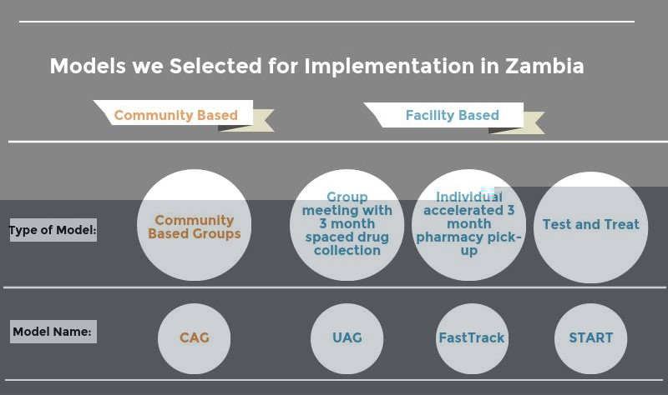
CAG = Community Adherence Group UAG = Urban Adherence Group START = Streamlined ART initiation

Slide 5
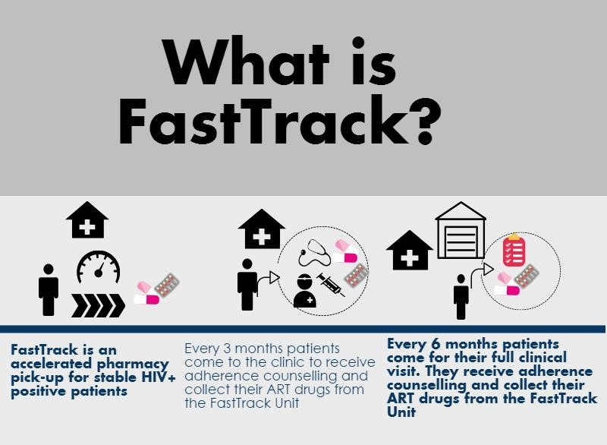

Slide 6
Implementation
Moderate Infrastructure resources were required for separate patient screening
Patients enthusiastic about differential processing at clinic
Ministry of health guidance modified to three month refills during model implementation

Slide 7
Results
The median pharmacy visit spacing for both intervention and control group was ~90 days
Among those that remained in care during the one-year of follow-up, those in the intervention group were less likely to be late for a scheduled pharmacy visit
Among the entire cohort of enrolled the positive effect of the interaction remained at 7, 14, 28, and 90 days lateness
Those in the intervention arm remained in care, on average, 41 days more than the control

Slide 8
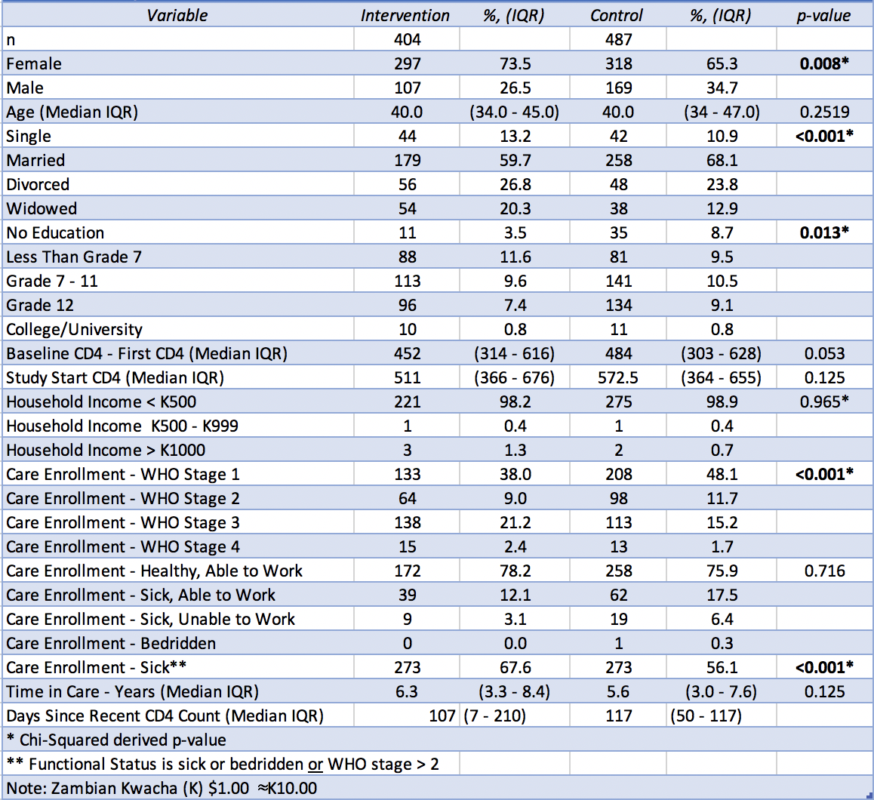
Table 1: Population Charcteristics
Notes:
Intervention group had more women and were older, more were not currently married,were educated, and WHO stage III and sick
The median age of patients upon enrollment in the intervention and control groups was 40 years of age with interquartile range of 34-45 and 33.5-47 years, respectively (p=0.252) Significant benefit in intervention at 180 and 365 days of follow-up time
318 (65.3%) females received standard of care compared to 297 (73.5%) who received the intervention (p=0.008)
Education differed the most across intervention status among those reported no education with 35 (8.7%) patients who received SOC compared to 11 (3.5%) who received the intervention (p=0.013)

Slide 9
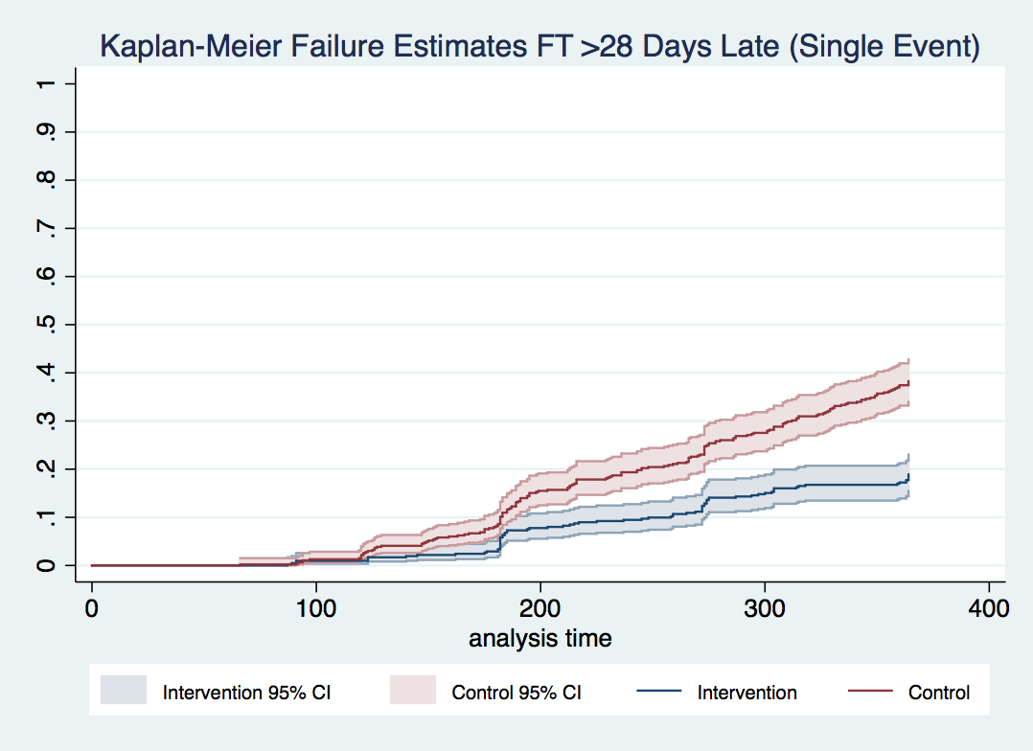
More in the control group were >28 days for pharmacy pick-up
Notes:
Greater than 28 days beyond the last visit appointment date
Significant benefit in intervention at 180 and 365 days of follow-up time
Log Rank Results:
109 observed events of individuals >28 days late for appointed visit date when we expect 184 (59.2%)
250 observed events of individuals >28 days late for appointed visit date when we expect 176 (142.0%)

Slide 10
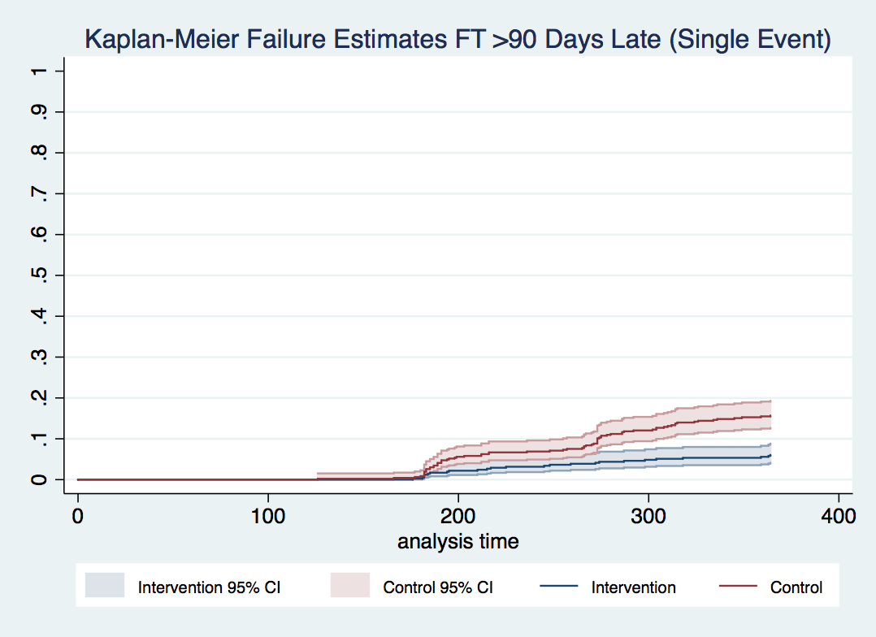
Fewer in the intervention group were >90 days late
Notes:
Greater than 90 days out of care
Significant benefit in intervention at 365 days of follow-up time

Slide 11
HCWs agreed adherence was good
    “Adherence of these clients was very good. Only in a few cases, we didn’t have the latest results because we didn’t collect blood from the client on time. But mostly when you review their files, you find there is no RNA detected. Most of them are virally suppressed.”
-FGD-Makeni-Profession HCW Participant#6
“It has also improved the health of the clients because defaulter rates have reduced. Initially people were afraid to frequently ask for permission at work as they would spend the whole day here (at the clinic)…”
-IDI Matero, Lay HCW
Notes:
Patients reported being able to honor appointments because of reduced waiting time, as said by a female patient in Makeni clinic [next slide]

Slide 12
Patients have jobs as well
  “You find that the boss wants you to report around 06:00 hours. Then you ask the boss if you can report around 08:00 hours. If the boss agrees, with FastTrack, you can come at 07:00 hours, 7: 15 hours you are on the bus; then by 07:50 hours you reach your office.”
-FGD-Makeni-Female Participant#3
“The time that we used to come here in the morning and get back in the evening is not there anymore, so I felt good.”
-FGD Matero, Female Participant
Notes:
[read quote]

Slide 13
Both HCWs and patients reported health system issues
  “From the time FastTrack started, they did not say that the drugs are a problem until this month, just recent the one, … They said the drugs are a few, that they will just give us enough drugs for one month but to return in two weeks to get the fill three months’ supply.”
  -FGD-Matero-Male Participant#2
  “The order of specimen bottles should be on time, and some drugs should be ordered on time. They should also increase the number of workers as well as resources.”
-FGD-Matero-LHCW#1
Notes:
Some of the issues point to the fact that study staff implemented Fast Track and did not always communicate well with professional staff. Other problems related to periodic shortages

Slide 14
Conclusions
Fast Track shows an improvement in patient keeping next visit appointment as well as retention to care at >7, >14, and >28 days at one year follow-up
The effect of Fast Track at greater than 90 days late , for appointment, or the previous definition of lost, was improved in the intervention group compared to the control at one year of follow-up.
Because both routine and Fast Track models provided 3 month refills the difference in effect may be attributed to the expedited clinic visit.
Notes:
Not sure this second point is necessary?

Slide 15
Implications
Fast Track reduces short-term lapses in care and represents a promising model for differentiated service delivery.
Research on standardized assessment of health systems capabilities can help prioritize particular DSD models in particular settings.
Minimizing the burden of frequent appointments improves retention – a lesson that may have broad implications for innovative health services outside of HIV as well as within HIV.

Slide 16



Thank You
Questions?
We would like to thank the Zambian Ministry of Health, Ministry of Community Development and Social Welfare, and all participating patients and health workers.

